Slide 1
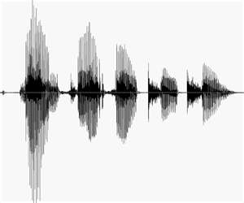
Public Speaking

Slide 2
INTRODUCTION
About Public Speaking
Do’s & Don’ts
Tips
Assignment

Slide 3
ABOUT PUBLIC SPEAKING
Why?
“Learning how to become an effective public speaker can be the key difference between success and failure in your life at home, at work and in your own community!”
-- SpeakingAndSpeeches.com

Slide 4
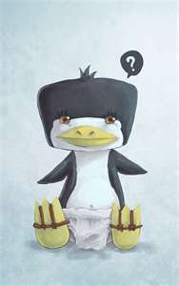
ABOUT PUBLIC SPEAKING
Why?
Academic Presentation
Job Interview
Sales
Business Proposal
Company Meeting
Management Training

Slide 5
DO’s
Relax
Be Prepared
Be Aware of Your Audience
Practice
RELAX!!!

Slide 6
DO’s
Relax
What are you afraid of
Fear of Public Speaking is #1
1. Fear of Public Speaking
2. Fear of Death
3. Fear of Spiders
4. Fear of Darkness
5. Fear of Heights
-- thanetspeakers.org.uk

Slide 7

DO’s
Relax
This is a safe place to practice
You are among friends

Slide 8
DO’s
Be Prepared, Part I
Use the Step-by-Step Guide
Understand your topic & purpose
Know what you are talking about
Research & Study the topic
Create an outline
→ Map to success

Slide 9
OUTLINE EXAMPLE
I. Introduction
    A. Opening Statement
    B. Thesis
II. Body
    A. Supporting Argument #1
    B. Supporting Argument #2
    C. Supporting Argument #3
III. Conclusion
    A. Summary
    B. Closing Statement

Slide 10
DO’s
Be Prepared, Part II
Confidence
Body Language
Voice Control

Slide 11
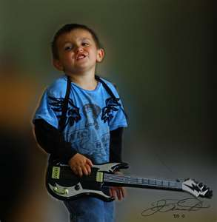
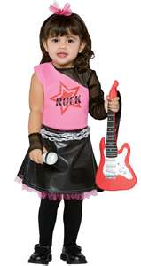
DO’s
Confidence
Preparation
You are the Expert!
Center of Attention
You are the Star!

Slide 12

DO’s
Body Language
Mood / Attitude
Non-verbal Communication
  Facial expressions
  Arms / hands
  Stance
3. Eye Contact

Slide 13
DO’s
Voice Control
Volume
→ Change it for variety or to emphasize key points.
Speed
→ Take your time. Don’t go too FAST!
Pronunciation
→ Speak clearly.

Slide 14
DO’s
Audience Awareness
→ Questions before presentation
Who will you be speaking to?
Is your material appropriate?
What kind of response do you want them to have?

Slide 15
DO’s
Audience Awareness
→ Questions during presentation
Are you communicating well?
Are you involving the audience?
How are they reacting?

Slide 16
DO’s – Textbook
Use a Physical Activity
Start with statement or statistics
Start with a joke or question
Start with a quotation or image
Tell a story

Slide 17

Q&A
Questions or Comments?

Slide 18
DON’Ts
Common Mistakes
Hiding / Reading
Filler Words & Sounds
→ Umm, Ahh, or 那个… 那个
Not Enough Pauses
Apologetic (Shows lack of confidence)

Slide 19
DON’Ts
Common Mistakes, continued
Curse Words
Unnecessary Big Words
Bragging
Go on longer than time allowed

Slide 20
DON’Ts – Textbook
Begin with “Hi, my name is…”
Make a false start – apologies, etc.
Use rhetorical question
Go overboard
Fail to consider how to get to podium

Slide 21
TIPS
Opening & Closing Statements
Opening statement:
→ Say or do something to get your audience
listening.
Closing statement:
→ Say or do something to show you have finished
and which they will remember.

Slide 22
TIPS
Involve the Audience
Ask Questions
→ Try to use more open-ended questions rather
than Yes/No questions.
Use Activities
→ Play a game or have a project.

Slide 23
PUBLIC SPEAKING EXAMPLE
Items to Watch For
Confidence Body Language A. Mood / Attitude B. Non-Verbal Communication (Hands, Movement) C. Eye Contact | Voice Control A. Volume B. Speed C. Pronunciation Audience Awareness

Slide 24

PUBLIC SPEAKING EXAMPLE
Derek Sivers

Slide 25
PRACTICE
Practicing Methods
Do it aloud
Do it at least 3 times
Practice with friends and in front of a
mirror

Slide 26
SUMMARY
Things to Remember
Speaking in public well will help you be successful.
Relax
→ Take deep breaths to calm yourself

Slide 27
SUMMARY
Things to Remember, continued
3. Be prepared
Understand Purpose
Know Topic
Use Outline
Confidence
Body Language
Voice Control

Slide 28
SUMMARY
Things to Remember, continued
3. Focus on the Audience
Make speech appropriate
Involve audience with questions & activities
Aim to achieve specific goals from audience
4. Practice

Slide 29
ASSIGNMENT
Speaking in Public –Introduction
Prepare a introduction of your partner.
→ No longer than 3 minutes
We want to know
  Name and where are they from?
  Favorite hobby
  Something special or funny

Slide 30
ASSIGNMENT
Preparation for Next Class
Read Unit 2, pages 23-43
Complete exercises:
A. Vocabulary Readiness, pages 23-25
B. Reading Comprehension 1 & 2, pages 30-
33 (exclude Open Ended Questions)

Slide 31
Q&A
Questions or Comments?

